Slide 1
CORE COMPETENCIES
@ PORTER CREEK SECONDARY

Slide 2
WHAT ARE THE CORE COMPETENCIES?

Slide 3
PERSONAL AND SOCIAL CORE COMPETENCY
THREE FACETS OF THIS COMPETENCY:
POSITIVE PERSONAL AND CULTURAL IDENTITY
PERSONAL AWARENESS
SOCIAL RESPONSIBILITY
TOGETHER THEY FORM THE SET OF ABILITIES THAT RELATE TO STUDENTS’ IDENTITY IN THE WORLD, BOTH AS INDIVIDUALS AND AS MEMBERS OF THEIR COMMUNITY AND SOCIETY. THIS COMPETENCY FOCUSES ON THE ABILITIES STUDENTS NEED TO THRIVE AS INDIVIDUALS AND TO UNDERSTAND AND CARE ABOUT THEMSELVES AND OTHERS

Slide 4
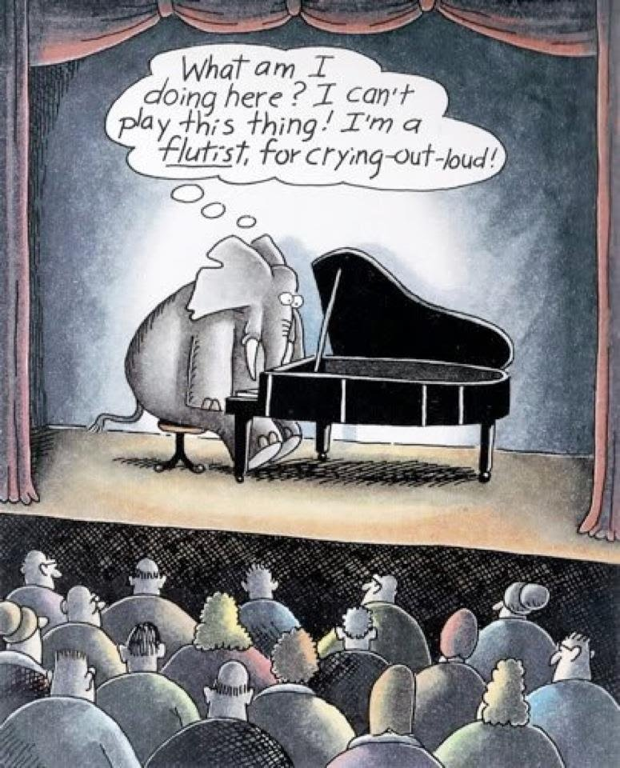
IMPORTANCE OF STUDENT VOICE “This is who I am, this is who I am becoming”
THE GOAL IS FOR STUDENTS TO OWN THE CORE COMPETENCIES, BE ABLE TO SPEAK ABOUT WHO THEY ARE IN RELATION TO THESE, AND PRESENT A PROFILE OF THEMSELVES. IT IS AN OPPORTUNITY FOR STUDENTS TO DESCRIBE WHO THEY ARE IN A HOLISTIC WAY, BRINGING ALL THEIR EXPERIENCES, STRENGTHS, AREAS THEY ARE WORKING ON, THEIR UNIQUE TALENTS AND GIFTS TO THEIR PROFILE.
- PAT HORSTEAD

Slide 5
POSITIVE PERSONAL AND CULTURAL IDENTITY
A POSITIVE PERSONAL AND CULTURAL IDENTITY IS THE AWARENESS, UNDERSTANDING, AND APPRECIATION OF ALL THE FACETS THAT CONTRIBUTE TO A HEALTHY SENSE OF ONESELF. IT INCLUDES AWARENESS AND UNDERSTANDING OF ONE’S FAMILY BACKGROUND, HERITAGE(S), LANGUAGE(S), BELIEFS, AND PERSPECTIVES.

Slide 7
I’M NOT HERE TO BE WELL BALANCED OR ADMIRED. I’M HERE TO BE AN ODDBALL, ECCENTRIC, DIFFERENT, WILDLY IMAGINATIVE, CREATIVE, DARING, CURIOUS, INVENTIVE AND EVEN A TAD STRANGE AT TIME. I’M HERE TO PRAY AND CHANT AND MEDITATE AND SING AND FIND CREATOR IN A BLUES RIFF, A SUNRISE, A TOUCH OR THE LAUGHTER OF CHILDREN. I’M HERE TO DISCOVER ME IN ALL OF THAT. I’M HERE TO ADD CLUNKY, CHUNKY AND FUNKY BITS OF ME TO THE SWIRL AND SWAGGER AND CHURN OF LIFE AND LIVING. IT DEMANDS I BE AUTHENTIC. SO WHEN YOU LOOK OUT AT THE WORLD, THAT’S ME DANCING IN THE FIELDS...
- RICHARD WAGAMESE IN EMBERS

Slide 9
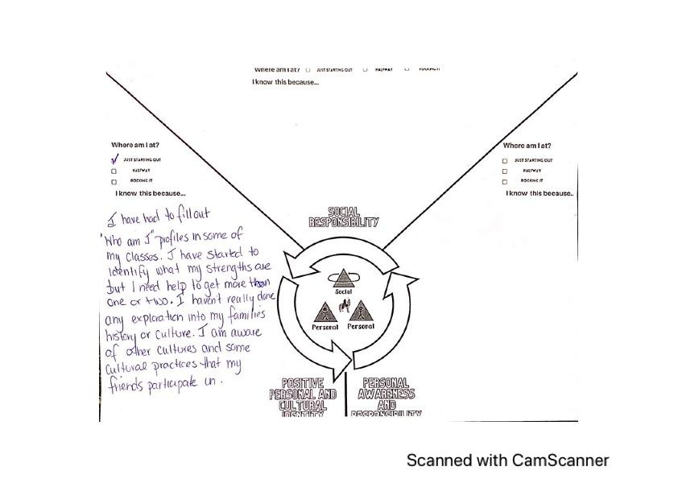

Slide 10
PERSONAL AWARENESS
Personal awareness and responsibility includes the skills, strategies, and dispositions that help students to stay healthy and active, set goals, monitor progress, regulate emotions, respect their own rights and the rights of others, manage stress, and persevere in difficult situations. Students who demonstrate personal awareness and responsibility demonstrate self-respect and express a sense of personal well-being and advocacy.

Slide 11
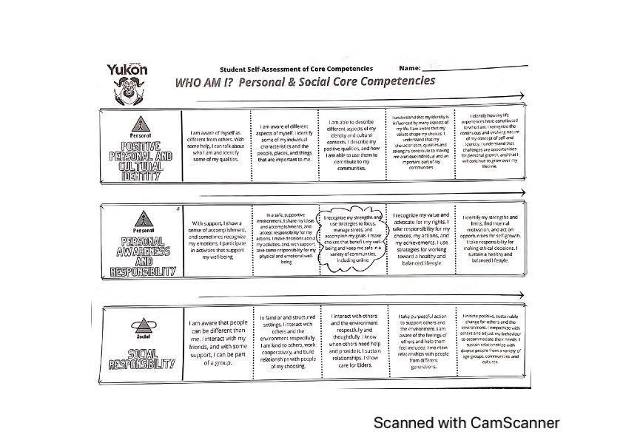

Slide 12
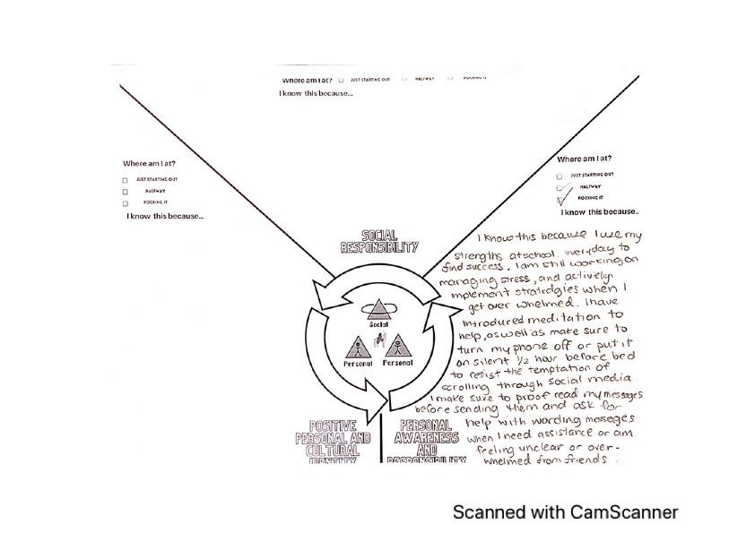

Slide 13
SOCIAL RESPONSIBILITY
Social responsibility involves the ability to consider the interdependence of people with each other and the natural environment; to contribute positively to one’s family, community, society, and the environment; to resolve problems peacefully; to empathize with others and appreciate their perspectives; and to create and maintain healthy relationships.

Slide 14
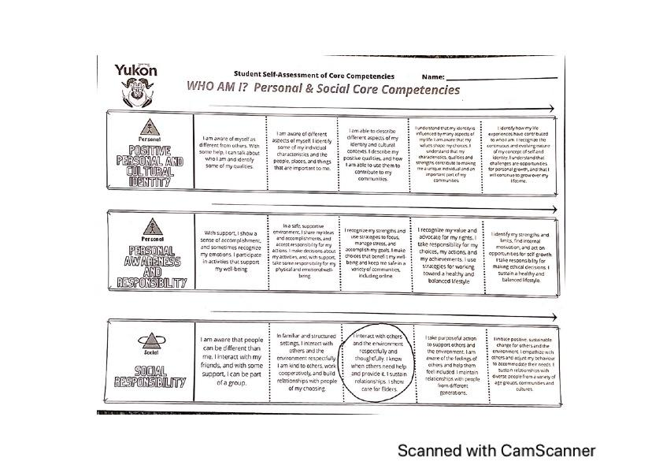

Slide 15
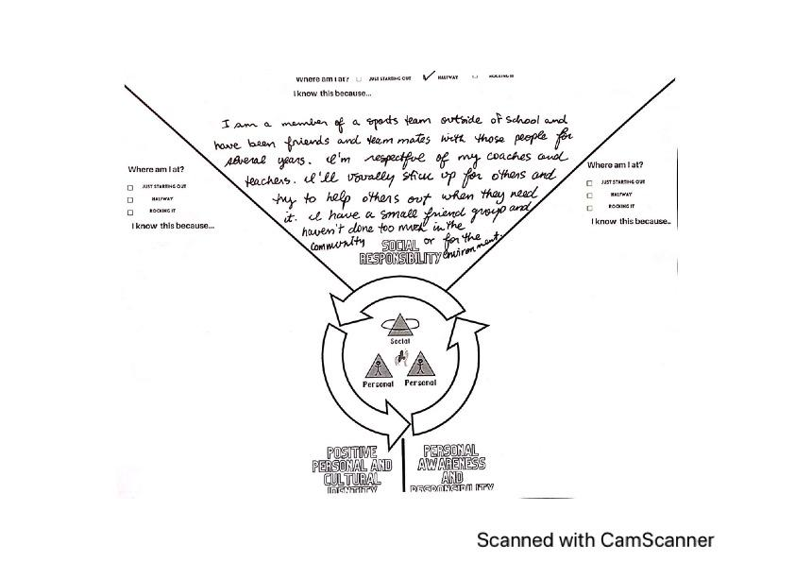

Slide 16
Now it’s your turn! Fill out the Self-Assessment Rubric for Personal Social Core Competencies and provide evidence of where you rated yourself.

